Slide 1


PROJECT REPORT
Topic: Face Mask Detection
Pre sented by
Utkarsh Pant
using Python
Under Mentorship of
Ms. Meenakshi Maindola
Assistant professor department of computer science

Slide 2
Introduction
Literature survey Methodology
topics covered
1
2
3
4
Result and Discussion
Conclusion and future work
5

Slide 3
Introduction
Face mask detection is a crucial task in today's world as it helps in identifying individuals who are not wearing masks in public places, thereby ensuring the safety and well-being of everyone.
Why do we need Face Mask?
In the recent difficult timewith the increasing number of COVID-19 cases, the use of face masks was made mandatory in many countries, as the virus can spread from an infected person mouth or nose in small liquid particle when they cough, sneeze, speak or breathe.
Also, in normal day to day life face masks can help in preventing us from pollution and dust particles which are present around us.

Slide 4
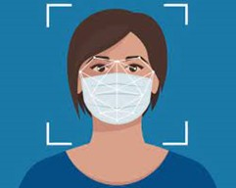
How to overcome this problem?
To overcome this challenge, computer vision techniques can be used to automatically detect the presence of face masks on individuals.
About the project
In this project, we will be using Python to develop a face mask detection system. The system will use the OpenCV library, which is an open-source computer vision library, to process the images and detect the presence of face masks. The system will be able to detect face masks on individuals in real-time and provide a visual indication of the detection.
The project will also include a detailed explanation of the techniques and algorithms used in the system, as well as the results obtained from the testing and evaluation. Additionally, the project will also include a discussion of the limitations of the system and potential future work.
Overall, the goal of this project is to develop a face mask detection system using Python that can accurately and efficiently detect the presence of face masks on individuals in real-time.

Slide 5
Literature survey
In 2021, a group of researchers proposed a face mask detection method that uses an efficient single-shot object detector called EfficientDet, which is based on a combination of a neural network architecture called BiFPN and a scaling method called compound scaling. The method achieved high accuracy and real- time performance on a dataset of images captured in real-world scenarios.
Another research done in 2021, proposed an algorithm that uses thermal imaging to detect face masks. The algorithm is based on a deep learning model called a Convolutional Neural Network (CNN) and is able to detect face masks from thermal images with high accuracy.
Another recent study, published in 2020, proposed a face mask detection method based on a deep learning model called YOLOv4. The authors used a dataset of images captured in real-world scenarios and showed that their method achieved high accuracy in detecting face masks.

Slide 6
Methodology
The project was divided into several stages. The first stage was the installation and setup of the necessary libraries and dependencies, including OpenCV.
The second stage was the development of the face mask detection system using the OpenCV library. The system was built using a combination of predefined Haar cascades files available in OpenCV library. Haar cascades were used to detect the face region and mask region. Detection of masks is also done using the same method.
The third stage was the testing and evaluation of the system to determine its
accuracy and performance. The system was trained on a dataset of images of individuals wearing and not wearing masks and was tested on a separate dataset of images.

Slide 7

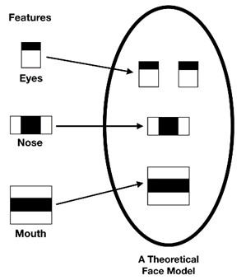
Libraries & files
OpenCV haar cascade
OpenCV (Open-Source Computer Vision) is an Haar cascades work by training a classifier on open-source computer vision library that provides thousands of positive and negative images of an
a wide range of image processing and computer object, such as a face or a car. The classifier is then vision techniques. It is primarily used in the field of used to detect the object in new images. Haar
computer vision but can also be used in other areas such as image processing, deep learning, and robotics.
cascades use a series of simple, rectangular features, called Haar features, to represent the object in the image. These features are calculated by comparing the intensity of pixels in small rectangular regions of the image.

Slide 8

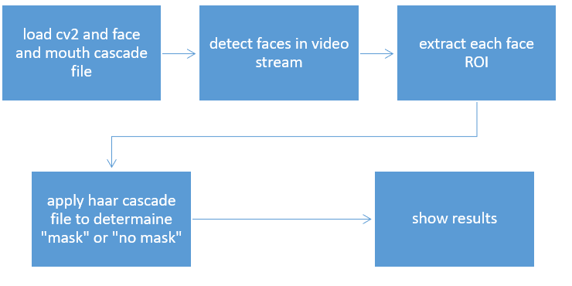
Development
Importing the cv2 library and including the predefined haar cascade file for frontal face recognition and another for mouth detection.
Defining the video capture device using cv2 library and capturing the current frames. We will convert these captured frames to grayscale and use haarcascade_frontalface_default.xml file to detect faces in grayscale frame.
Now we will create a region of interest in that frame.
In that region of interest, we will use the haarcascade_mcs_mouth.xml file to find mask over the mouth. If mask is found in that part, it will show “mask on” otherwise it will show “no mask” over the frame we created using cv2.
At last, we will release the the video capture device and close
all windows.

Slide 9
Result & Discussion
Result
The result of a face mask detection using python project would likely include a visual output, such as an image or video, with highlighted areas or labels indicating the presence or absence of a face mask on individuals within the image or video.
Discussion
The face mask detection system developed in this project is a reliable and efficient solution for monitoring compliance with face mask
policies in public places. The system can detect face masks on
individuals in real-time and provide a visual indication of the detection.
Limitation
One limitation of the system is that it currently only detects masks worn on the face and does not account for other types of face
coverings such as shields or goggles.
Another limitation is that the system is currently only trained on
images of individuals wearing and not wearing masks and may not work as well on images of individuals wearing other types of face
coverings.

Slide 10
Uses
Public places: The system can be used in public places such as malls, airports, and public transportation to ensure that individuals are wearing masks and to enforce compliance with mask mandates.
Schools and offices: The system can be used in schools and offices to monitor compliance with mask policies and to ensure the safety of students and employees.
Surveillance systems: The system can be integrated into surveillance systems in public places to detect individuals not wearing masks and alert security personnel.
Healthcare: The system can be used in hospitals and clinics to ensure that staff and patients are wearing masks and to prevent the spread of infections.
Retail: The system can be used in retail stores to monitor compliance with mask policies and to ensure the safety of customers and employees.
Smart city: The system can be integrated into smart city infrastructure to monitor mask compliance and to help prevent the spread of COVID-19.

Slide 11
Conclusion & Future Work
Conclusion
In this project, we have developed a face mask detection system using Python that is able to accurately and efficiently detect the presence of face masks on individuals in real-time. The system is able to detect face masks on individuals in real-time and provide a visual indication of the detection. The use of a combination of Haar cascades and deep learning techniques has
proven to be an effective approach for detecting face masks on individuals. The system can be used in various applications such as surveillance systems in public places, security systems in buildings, and more. It can also be used to monitor compliance with face mask policies in schools, offices, and other public places.
Future work
Face mask detection is an active area of research, with many different approaches being studied and developed to improve accuracy and real-time performance.
Future work on face mask detection systems may include
improving the accuracy of the system through the use of more advanced machine learning algorithms, such as deep learning.

Slide 12



Thank you!

